Slide 1
Conceptualizing and Initializing the IT Project
Chapter 2
ISYS 663
Dr. Leigh Jin

Slide 2
Learning Objectives
Describe the project life cycle (PLC) and the systems development life cycle (SDLC)
Identify the phases and infrastructure that make up the IT project methodology.
Understand and Develop a project’s measurable organizational value (MOV).
Understand what is a business case.
Understand how to calculate ROI and NPV.
Understand Weighted Scoring Model
2-<number>

Slide 3
The Project Life Cycle and IT Development
Project Life Cycle
  Collection of logical stages or phases that maps the life of a project from its beginning to define, build, and deliver the product
  Each phase should provide one or more deliverables
Deliverable
  Tangible and verifiable product of work
  Project plan, design specifications, delivered system
2-<number>

Slide 4
Project Phases
Phase Exits, Stage Gates, Kill Points
  These are the phase-end review of key deliverables
  Allows the organization to evaluate project performance and take immediate action to correct errors or problems
Fast Tracking
  Starting the next phase of a project before approval is obtained for the current phase
  Can be used to reduce the project schedule
  Can be risky and should only be done when the risk is acceptable
2-<number>

Slide 5
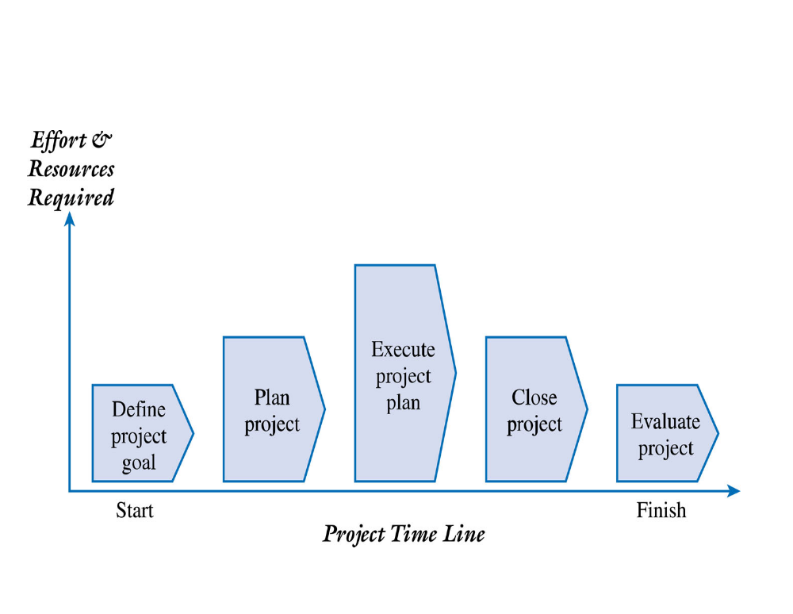
Generic Project Life Cycle
2-<number>

Slide 6
Project Life Cycle
Define Project Goal
  The project goal should be focused on providing business value to the organization
  Provides a clear focus and drives the other phases of the project
  How will we know if this project is successful given the time, money, and resources invested?
Plan Project
  Defines the agreed upon scope, schedule, and budget
  Used as a tool to gauge the project’s performance throughout the life cycle.
2-<number>

Slide 7
Project Life Cycle
Execute Project Plan
  Manage the project scope, schedule, budget, and people to ensure the project achieves its goal
  Progress must be documented and compared to the baseline plan
  Project performance must be communicated to all of the stakeholders
Close Project
  Ensures that all of the work is completed as planned
  Final project report and presentation to the client
2-<number>

Slide 8
Project Life Cycle
Evaluate Project
  Lessons learned to determine those things to do the same and those things to change
  Evaluate team member performance
  May be audited by an outside third party
2-<number>

Slide 9
Systems Development Life Cycle (SDLC)
Planning
  Identifying and responding to a problem or opportunity
  Incorporates the project management and system development processes and activities
  Ensures that the goal, scope, budget, schedule, technology, and system development processes, methods, and tools are in place
Analysis
  A closer look at the problem or opportunity
  Documents the specific needs and requirements for the new system
2-<number>

Slide 10
Systems Development Life Cycle (SDLC)
Design
  The project team uses the requirements and “to be” logical models to design the architecture to support the new information system
  This includes designing the network, hardware configuration, databases, user interface, and application programs
Implementation
  The development of the system, testing, and installation
  Training, support, and documentation must also be in place.
Maintenance and Support
  The system is updated to respond to bugs, new features, or to adjust to a changing business environment.
2-<number>

Slide 11
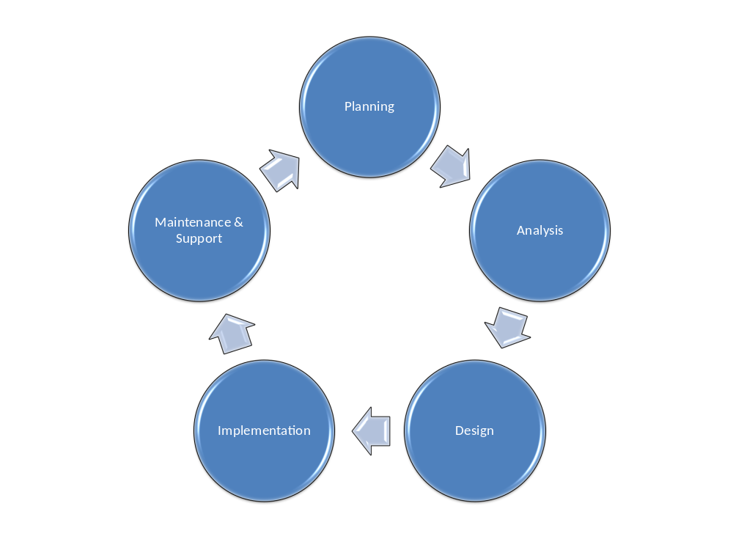
Systems Development Life Cycle
2-<number>

Slide 12
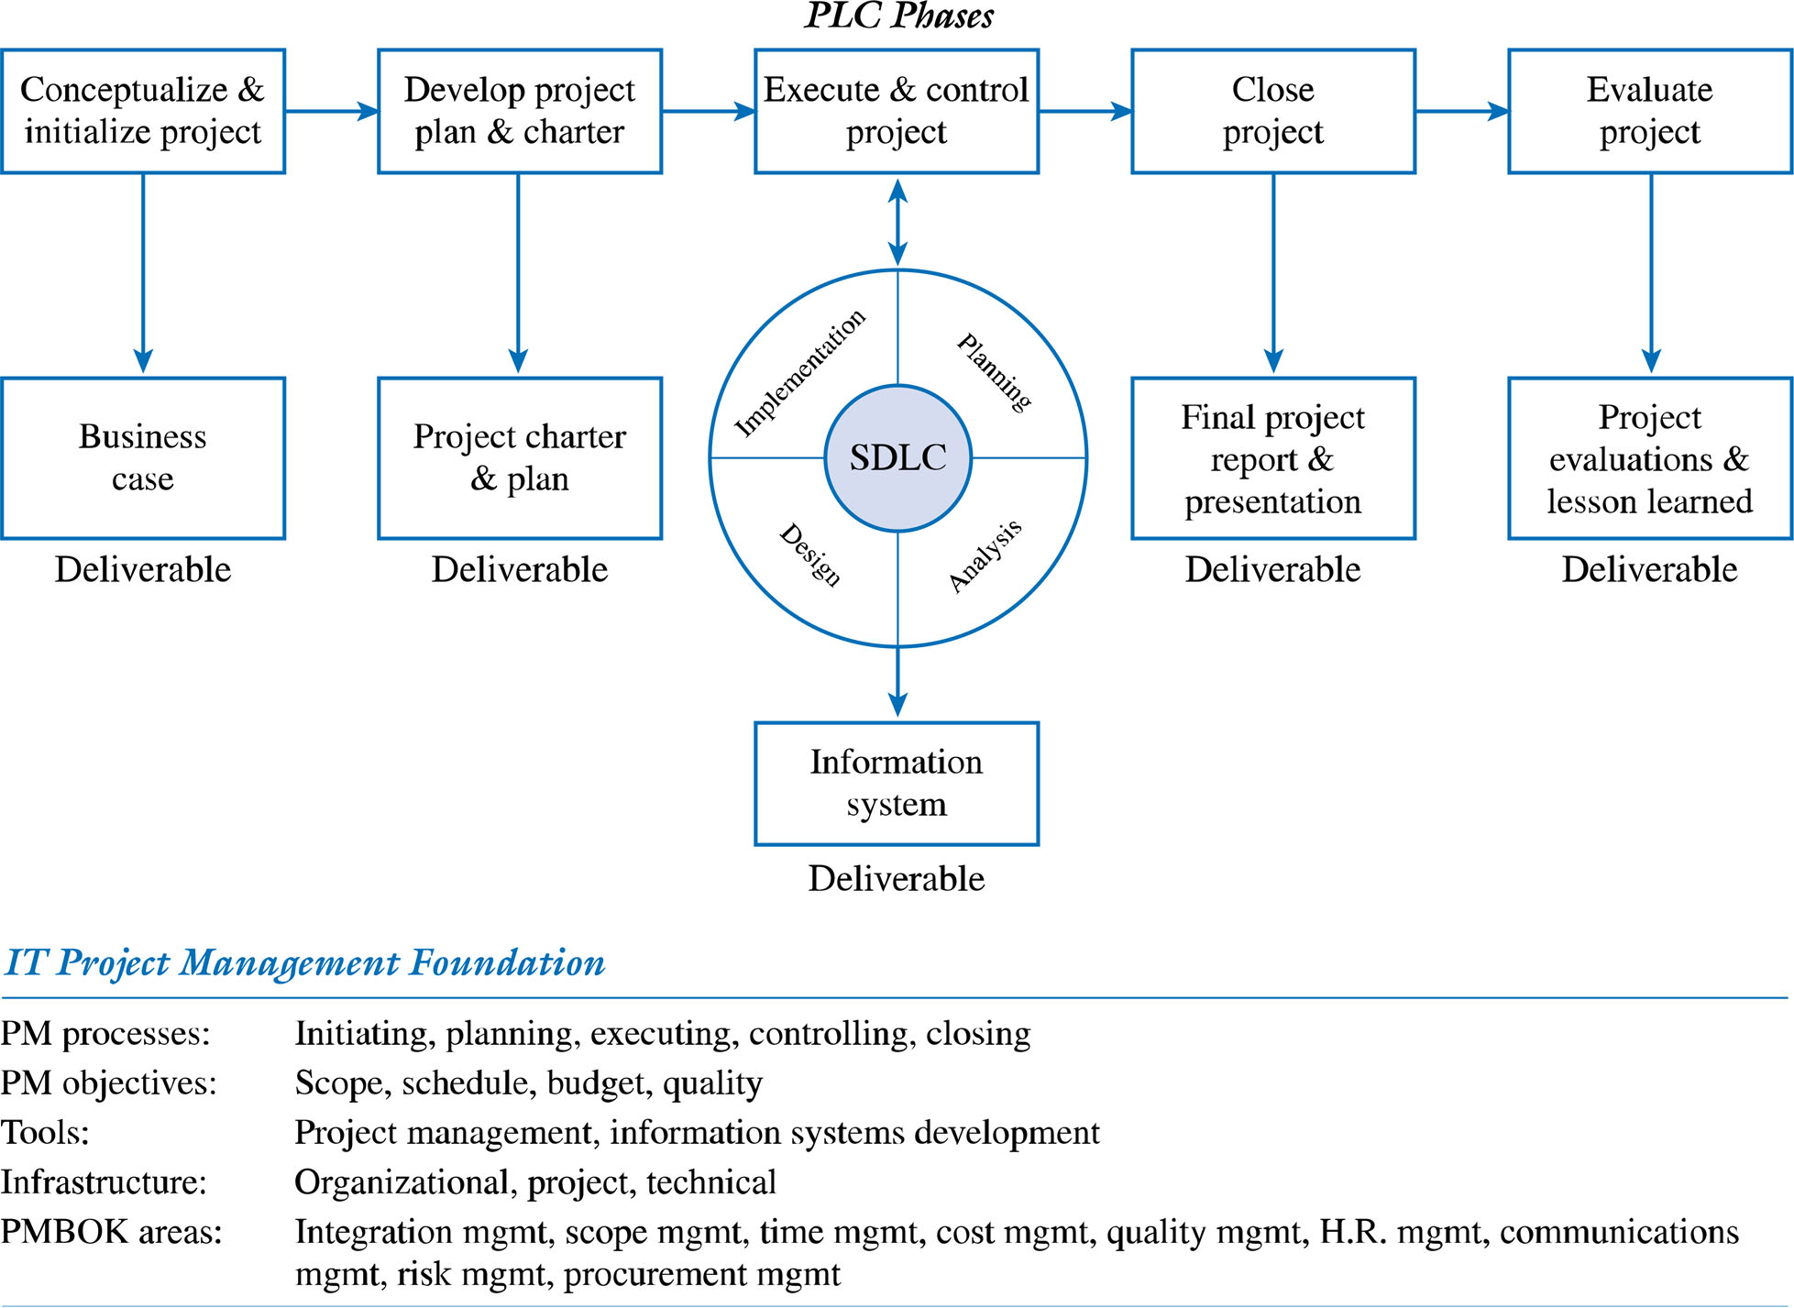
An IT Project Methodology
2-<number>

Slide 13
Phases
Phase 1: Conceptualize and Initialize
Phase 2: Develop the Project Charter and Detailed Project Plan defined in terms of project’s:
  scope
  schedule
  budget
  quality objectives
2-<number>

Slide 14
Phases continued
Phase 3: Execute and Control the Project using approach such as the SDLC.
Phase 4: Close Project
Phase 5: Evaluate Project Success
  Post mortem by project manager and team of entire project
  Evaluation of team members by project manager
  Outside evaluation of project, project leader, and team members
  Evaluate project’s organizational value
2-<number>

Slide 15
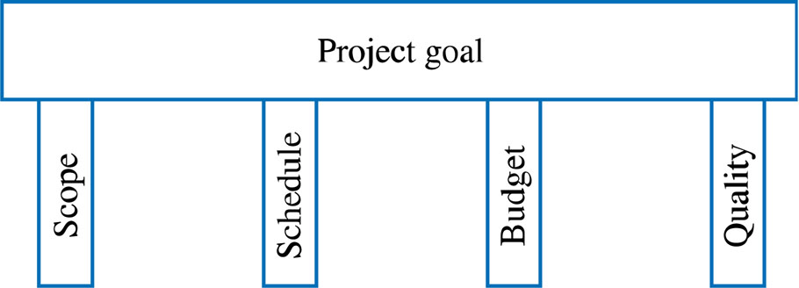
IT Project Management Foundation
Project Management Processes
  Initiating processes
  Planning processes
  Executing processes
  Controlling processes
  Closing processes
Project Objectives
2-<number>

Slide 16
IT Project Management Foundation
Tools - e.g. Microsoft Project ®, Computer Aided Software Engineering (CASE)
Infrastructure
  Organizational Infrastructure
  Project Infrastructure
    Project Environment
    Roles and Responsibilities of team members
    Processes and Controls
  Technical Infrastructure
Project Management Knowledge Areas
2-<number>

Slide 17
The Business Case
Definition of Business Case: an analysis of the organizational value, feasibility, costs, benefits, and risks of the project plan.
Attributes of a Good Business Case
  Details all possible impacts, costs, and benefits
  Clearly compares alternatives
  Objectively includes all pertinent information
  Systematic in terms of summarizing findings
2-<number>

Slide 18
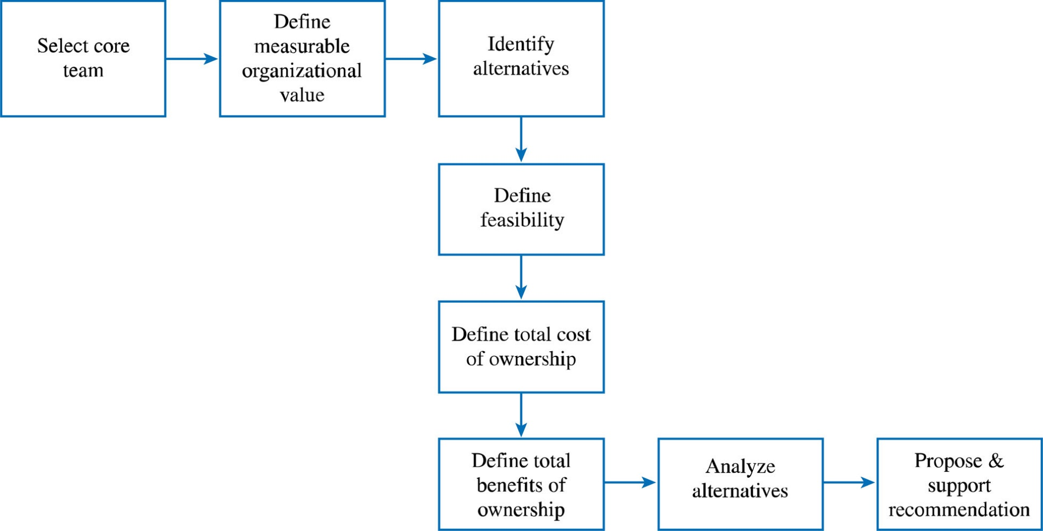
Process for Developing the Business Case
2-<number>

Slide 19
Developing the Business Case
Step 1: Select the Core Team (not “project team” yet)
Advantages:
    Credibility (including all stakeholders)
    Alignment with organizational goals
    Access to the real costs
    Ownership
    Agreement
    Bridge building
2-<number>

Slide 20
Developing the Business Case
Step 2: Define Measurable Organizational Value (MOV) the project’s overall goal
2-<number>

Slide 21
Measurable Organizational Value (MOV)
Step 2: Define Measurable Organizational Value (MOV) the project’s overall goal
  Must be measurable
  Provides value to the organization
  Must be agreed upon
  Must be verifiable at the end of the project
  Guides the project throughout its life cycle
  Should align with the organization’s strategy and goals
2-<number>

Slide 22
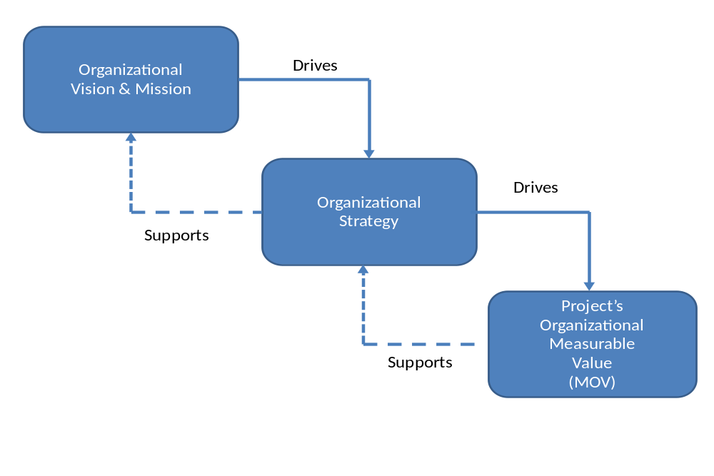
The IT Value Chain
2-<number>

Slide 23
Process for Developing the MOV
Identify the desired area of impact
Potential Areas:
  Strategic
  Customer
  Financial
  Operational
  Social
2-<number>

Slide 24
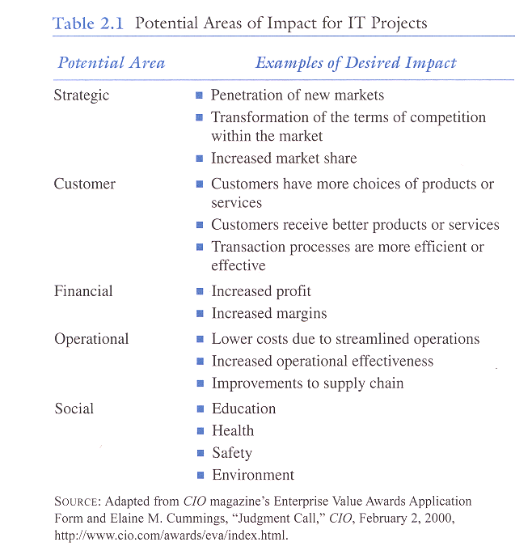
2-<number>

Slide 25
Process for Developing the MOV
Identify the desired value of the IT project
Organizational Value:
  Better?
  Faster?
  Cheaper?
  Do More? (growth)
2-<number>

Slide 26
Process for Developing the MOV
Develop an Appropriate Metric
      Should it increase or decrease?
Metrics:
  Money ($, £, ¥ )
  Percentage (%)
  Numeric Values
2-<number>

Slide 27
Process for Developing the MOV
Set a time frame for achieving the MOV
  When will the MOV be achieved?
Verify and get agreement from the project stakeholders
  Project manager and team can only guide the process
2-<number>

Slide 28
Process for Developing the MOV
Summarize the MOV in a clear, concise statement or table
This project will be successful if _________________.
MOV: The Web Site will provide a 20% return on
investment and 500 new customers within the
first year of its operation
2-<number>

Slide 29
Year | MOV
1 | 20% return on investment 500 new customers
2 | 25% return on investment 1,000 new customers
3 | 30% return on investment 1,500 new customers
Example MOV Using Table Format
2-<number>

Slide 30
Project Goal
Which one is the better goal?
  Install new hardware and software to improve our customer service to world class levels
  Respond to 95% of our customers’ inquiries within 90 seconds with less than 5% callbacks about the same problem.
2-<number>

Slide 31
A Really Good Goal
I believe that this nation should commit itself to achieving the goal before this decade is out, of landing a man on the moon and returning him safely to Earth.
John F. Kennedy
May 25, 1961
2-<number>

Slide 32
Developing the Business Case
Step 3: Identify Alternatives
  Base Case Alternative
  Possible Alternative Strategies
    Change existing process without investing in IT
    Adopt/Adapt systems from other organizational areas
    Reengineer Existing System
    Purchase off-the-shelf Applications package
    Custom Build New Solution
2-<number>

Slide 33
Developing the Business Case
Step 4: Define Feasibility and Assess Risk
  Economic feasibility
  Technical feasibility
  Organizational feasibility
  Other feasibilities
  Risk focus on
  Identification
  Assessment
  Response
2-<number>

Slide 34
Developing the Business Case
Step 5: Define Total Cost of Ownership
  Direct or Up-front costs
  Ongoing Costs
  Indirect Costs
Step 6: Define Total Benefits of Ownership
  Increasing high-value work
  Improving accuracy and efficiency
  Improving decision-making
  Improving customer service
2-<number>

Slide 35
Developing the Business Case
Step 7: Analyze alternatives using financial models and scoring models
  Net present value (NPV) analysis is a method of calculating the expected net monetary gain or loss from a project by discounting all expected future cash inflows and outflows to the present point in time
  Projects with a positive NPV should be considered if financial value is a key criterion, the higher the NPV, the better

Slide 36
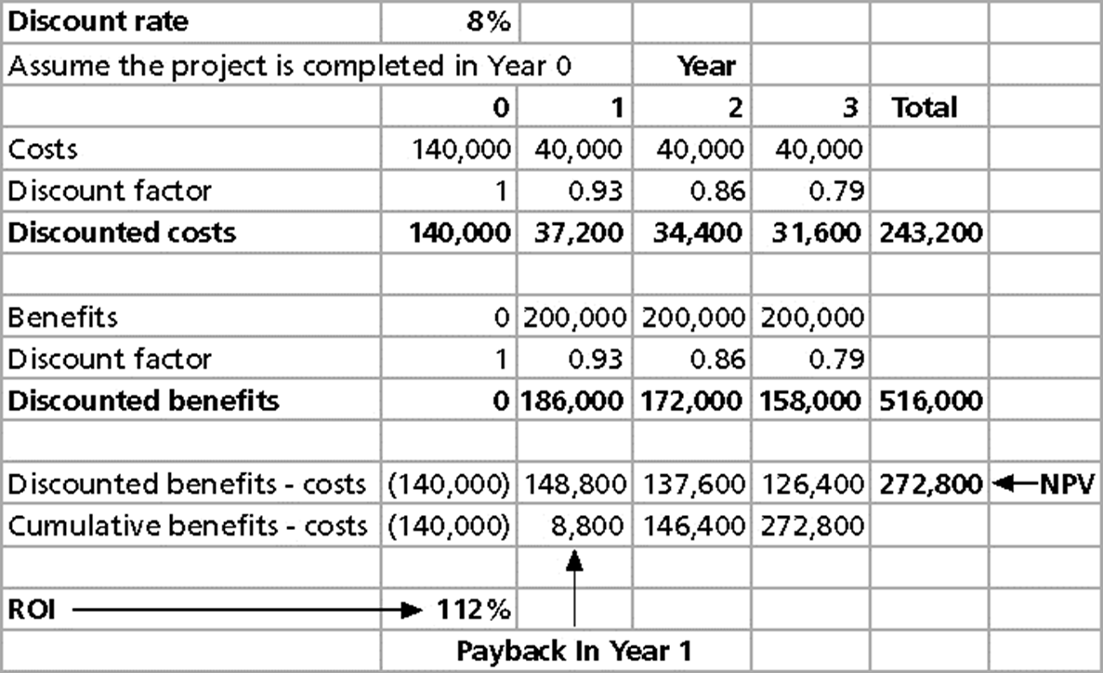
NPV and ROI Example

Slide 37
Return on Investment
Discount Factor = 1 / (1 + discount rate)^{year}
  year 0: 1 / (1 + 0.08)⁰ = 1
  year 1: 1 / (1 + 0.08)¹ = 0.93
Return on investment (ROI) is calculated by subtracting the project costs from the benefits and then dividing by the costs
  ROI = (total discounted benefits - total discounted costs)
  / discounted costs
  ROI = (516,000 – 243,200) / 243,200 = 112%
The higher the ROI, the better
Many organizations have a required rate of return or minimum acceptable rate of return on investment for projects
More than 82% of IT decisions required an ROI analysis

Slide 38
Payback Analysis
The payback period is the amount of time it will take to recoup, in the form of net cash inflows, the total dollars invested in a project
Payback occurs when the net cumulative discounted benefits equals the costs
  Cumulative benefits minus costs =
    last year’s cumulative benefits minus costs
    + this year’s discounted benefits minus costs
Many organizations want IT projects to have a fairly short payback period

Slide 39
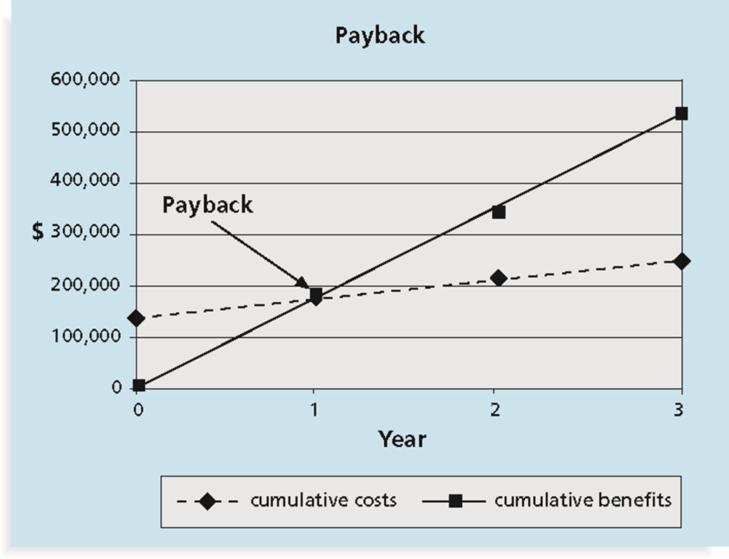
Payback Period

Slide 40
Weighted Scoring Model
A weighted scoring model is a tool that provides a systematic process for selecting projects based on many criteria
    Identify criteria important to the project selection process
    Assign weights (percentages) to each criterion so they add up to 100%
    Assign scores to each criterion for each project
    Multiply the scores by the weights and get the total weighted scores
The higher the weighted score, the better

Slide 41
Criterion |  | Weight | Alternative A | Alternative B | Alternative C
Financial | ROI | 15% | 2 | 4 | 10
 | Payback | 10% | 3 | 5 | 10
 | NPV | 15% | 2 | 4 | 10
Organizational | Alignment with strategic objectives | 10% | 3 | 5 | 8
 | Likelihood of achieving project’s MOV | 10% | 2 | 6 | 9
Project | Availability of skilled team members | 5% | 5 | 5 | 4
 | Maintainability | 5% | 4 | 6 | 7
 | Time to develop | 5% | 5 | 7 | 6
 | Risk | 5% | 3 | 5 | 5
External | Customer satisfaction | 10% | 2 | 4 | 9
 | Increased market share | 10% | 2 | 5 | 8
Total Score |  | 100% | 2.65 | 4.85 | 8.50
Notes: Risk scores have a reverse scale – i.e., higher scores for risk imply lower levels of risk
2-<number>

Slide 42
Developing the Business Case
Step 8: Propose and Support the Recommendation
  The Project Selection Decision
    Project must map to organization goals
    Project must provide verifiable MOV
    Selection should be based on diverse measures such as
      tangible and intangible costs and benefits
      various levels throughout the organization
2-<number>

Slide 43
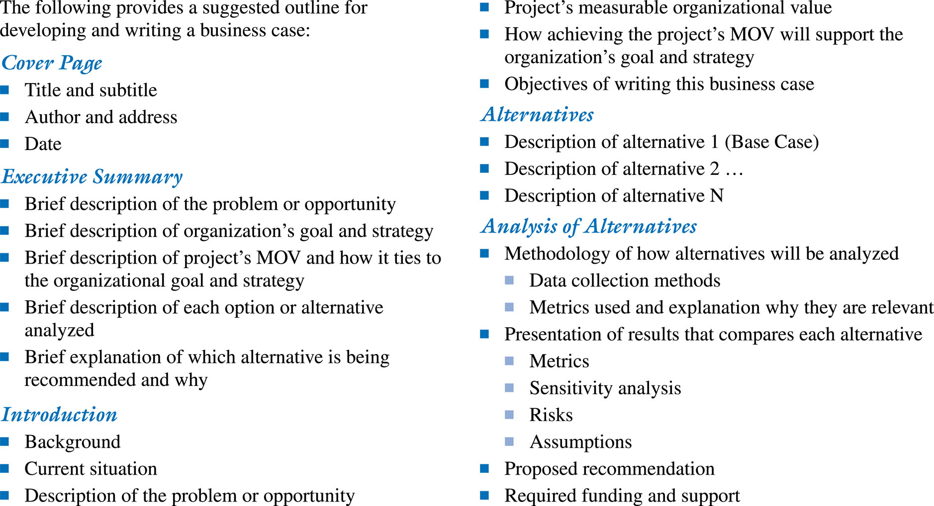
Business Case Template
2-<number>

